Slide 1

DGS General Coding Guideline

Slide 2
6.7 System Constants
Agenda
6.7.1 Definition properties
6.7.1.1 Categories
6.7.1.2 Sysco Values
6.7.1.3 Sysco Base Types
6.7.1.4 Sysco Computation Methods
2
Internal | RBVH/EJV3 | 2018-11-19
© Robert Bosch Engineering and Business Solutions Vietnam Company Limited 2018. All rights reserved, also regarding any disposal, exploitation, reproduction, editing, distribution, as well as in the event of applications for industrial property rights.

Slide 3
6.7.1.1 Categories
3
Internal | RBVH/EJV3 | 2018-11-19
© Robert Bosch Engineering and Business Solutions Vietnam Company Limited 2018. All rights reserved, also regarding any disposal, exploitation, reproduction, editing, distribution, as well as in the event of applications for industrial property rights.

Slide 4
6.7.1.1 Categories
6.7.1 Definition properties
System constants can be defined with three categories: FIXED, STABLE, ADJUSTABLE. The following conventions and processes shall be followed.
FIXED
Instruction:
The convention is that for fixed system constants the value never changes. If this system constant is used by two or more BCs, then it should be defined and owned to central elements by clearing request in the Architecture Clearing Portal Architecture Clearing Portal . If this system constant is used only in one BC, then it has to be defined and owned inside of this BC.
FIXED system constants shall only contain references to system constants of category FIXED.
4
Internal | RBVH/EJV3 | 2018-11-19
© Robert Bosch Engineering and Business Solutions Vietnam Company Limited 2018. All rights reserved, also regarding any disposal, exploitation, reproduction, editing, distribution, as well as in the event of applications for industrial property rights.

Slide 5
6.7.1.1 Categories
6.7.1 Definition properties
STABLE
Instruction:
They are defined and owned inside the BC (package local /decentral). Responsible for clearing is the belonging package responsible. It is neither part of central elements nor CONF package. If the value of the system constant is changed this normally requires a new variant of the BC.
STABLE system constants may contain references to system constants of category ADJUSTABLE, STABLE and FIXED.
5
Internal | RBVH/EJV3 | 2018-11-19
© Robert Bosch Engineering and Business Solutions Vietnam Company Limited 2018. All rights reserved, also regarding any disposal, exploitation, reproduction, editing, distribution, as well as in the event of applications for industrial property rights.

Slide 6
6.7.1.1 Categories
6.7.1 Definition properties
ADJUSTABLE
Instruction:
Used as variation points or "switchable features". All ADJUSTABLE system constants are centrally defined. Element declarations are done in the eASEE Normalization Editor by a clearing request in the Architecture Clearing Portal Architecture Clearing Portal. Value definition is done project specific in eASEE Implementation Editor. More instructions are given in See Chapter 6.7.3 "Adjustable System Constants " p. 86
ADJUSTABLE system constants may not contain any references to other system constants, regardless of which category (ADJUSTABLE, STABLE, FIXED). ADJUSTABLE system constants contain always values. (This rule is controlled by the eASEE system constant editor, this means only values are supported for ADJUSTABLE system constants.)
6
Internal | RBVH/EJV3 | 2018-11-19
© Robert Bosch Engineering and Business Solutions Vietnam Company Limited 2018. All rights reserved, also regarding any disposal, exploitation, reproduction, editing, distribution, as well as in the event of applications for industrial property rights.

Slide 7
6.7.1.2 Sysco Values
7
Internal | RBVH/EJV3 | 2018-11-19
© Robert Bosch Engineering and Business Solutions Vietnam Company Limited 2018. All rights reserved, also regarding any disposal, exploitation, reproduction, editing, distribution, as well as in the event of applications for industrial property rights.

Slide 8
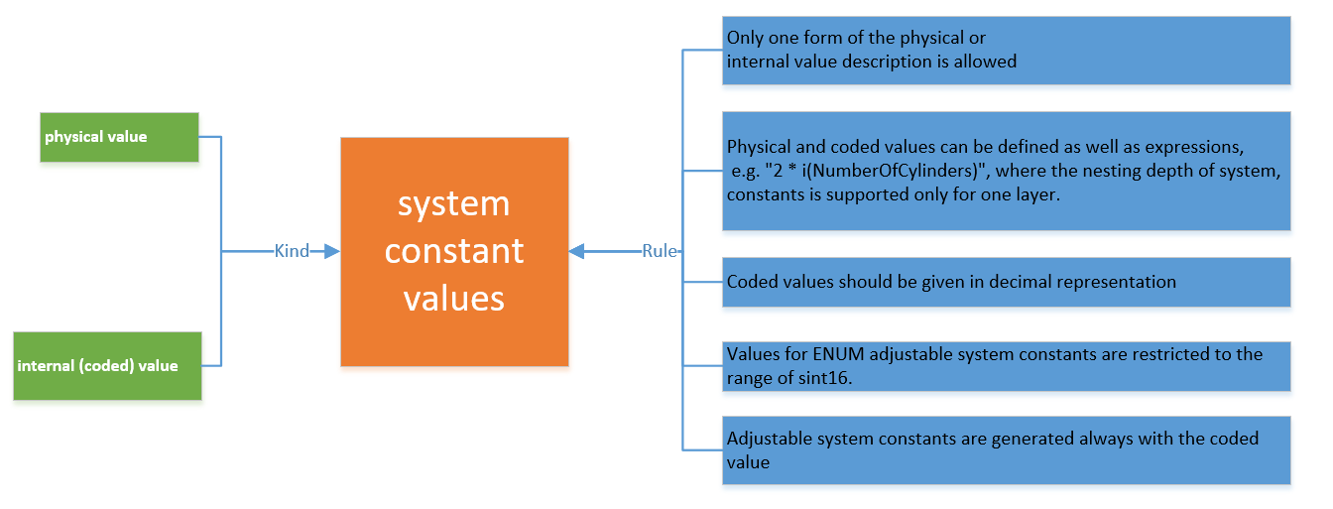
Sysco Values

Slide 9
6.7.1.3 Sysco Base Types
9
Internal | RBVH/EJV3 | 2018-11-19
© Robert Bosch Engineering and Business Solutions Vietnam Company Limited 2018. All rights reserved, also regarding any disposal, exploitation, reproduction, editing, distribution, as well as in the event of applications for industrial property rights.

Slide 10
Rules for the base types
6.7.1.3 Sysco Base Types
Base types are mandatory elements for system constants.
Base type sint8, sint16, sint32, uint8, uint16 (depend on the functional need)
The smallest integer type which can hold the internal value should be used
If the internal value is larger than MAXSINT32 then the base type uint32 shall be used
If the internal value is smaller than or equal MAXSINT32 then the base type uint32 shall not be used
The base type for ENUM adjustable system constants is always assigned to sint16
10
Internal | RBVH/EJV33 | 2018-11-19
© Robert Bosch Engineering and Business Solutions Vietnam Company Limited 2018. All rights reserved, also regarding any disposal, exploitation, reproduction, editing, distribution, as well as in the event of applications for industrial property rights.

Slide 11
System constant computation methods
6.7.1.4 Sysco Computation Methods
Values for system constants with computation method of category TAB_VERB shall only be set on coded (internal) level.
Value and base type shall not be deﬁned in contradiction. e.g.: a coded value 400 shall not be deﬁned by the base type uint8, a coded value 10.0 shall not be deﬁned as sint32.
11
Internal | RBVH/EJV33 | 2018-11-19
© Robert Bosch Engineering and Business Solutions Vietnam Company Limited 2018. All rights reserved, also regarding any disposal, exploitation, reproduction, editing, distribution, as well as in the event of applications for industrial property rights.

Slide 12
Q&A Section
12
Internal | RBVH/EJV3 | 2018-11-19
© Robert Bosch Engineering and Business Solutions Vietnam Company Limited 2018. All rights reserved, also regarding any disposal, exploitation, reproduction, editing, distribution, as well as in the event of applications for industrial property rights.

Slide 13
Thank you for listening!
13
Internal | RBVH/EJV3 | 2018-11-19
© Robert Bosch Engineering and Business Solutions Vietnam Company Limited 2018. All rights reserved, also regarding any disposal, exploitation, reproduction, editing, distribution, as well as in the event of applications for industrial property rights.

